Slide 1
DETERMINANTS

Slide 2
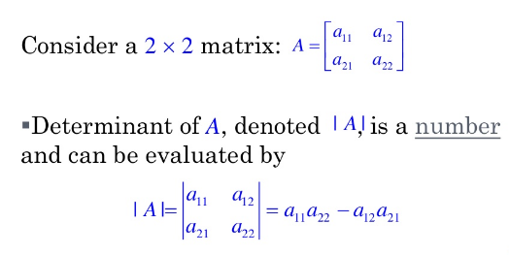

Slide 3
DETERMINANT OF ORDER 3X3

Slide 4
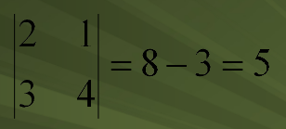
MINOR

Slide 5
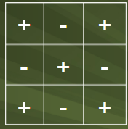
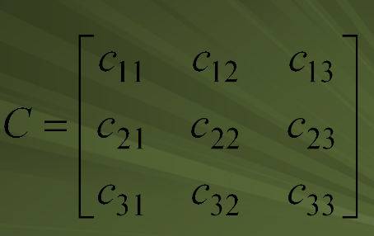
CO-FACTORS
CO-FACTOR MATRIX

Slide 6
EXAMPLE

Slide 7
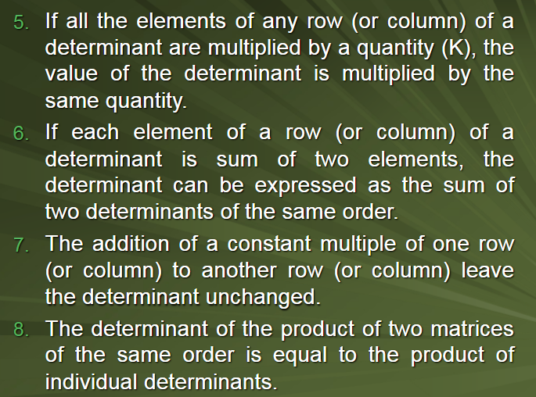

Slide 8
ADJOINT & INVERSE OF A MATRIX

Slide 9
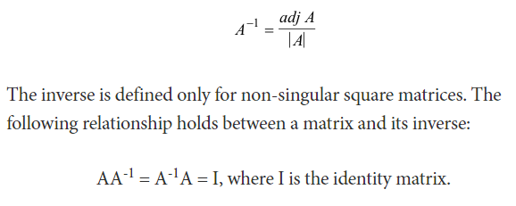
STEPS TO FIND INVERSE OF A MATIX

Slide 11
SOLUTION OF SYSTEM OF LINEAR EQUATIONS

Slide 12
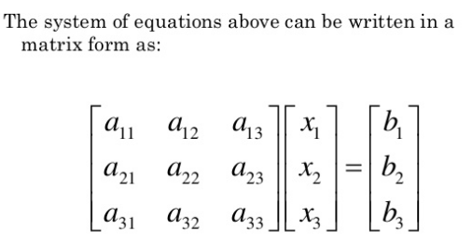
CRAMER’S RULE

Slide 13
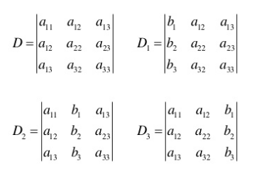
STEPS: CRAMER’S RULE
Note that D,D1,D2,D3 are given as

Slide 14
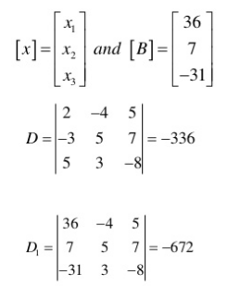
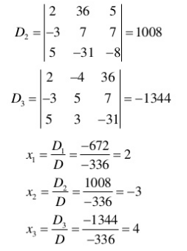
EXAMPLE

Slide 15
(i)If D=0, then we check if any of D1, D2 or D3 is not zero then system is inconsistent (ii)system is consistent with infinitely many solutions if D1=D2=D3=0 along with D=0
(iii) In case (ii) above we replace any one variable by a constant k and proceed in two variables only

Slide 16
THANK YOU

